Slide 1


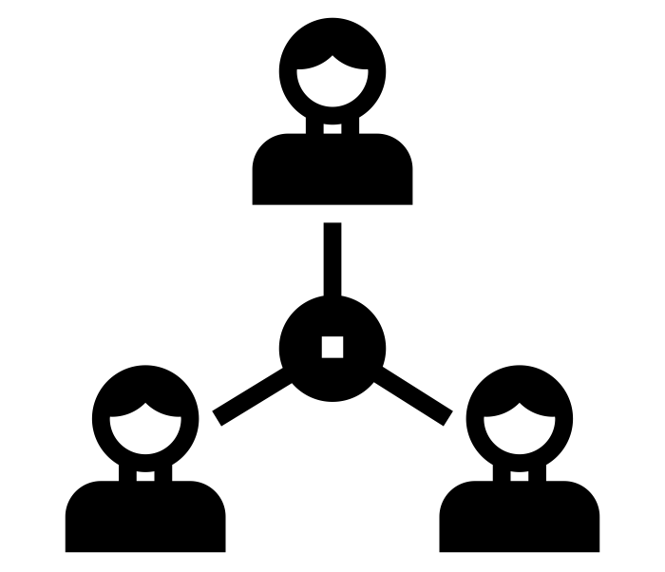

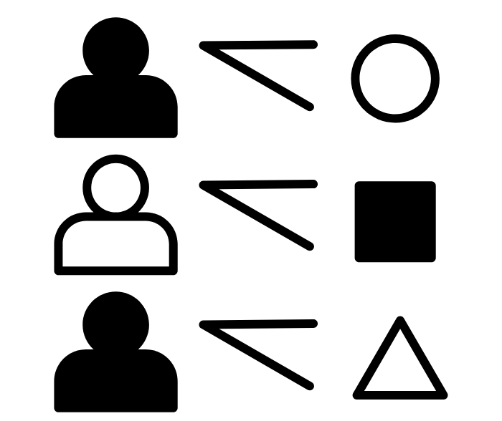



















Themes
Perspectives
Research Methods
How does class, gender and ethnicity impact individuals in society?
How different sociologists view and deal with social problems
Introduction to the methods used in sociological research
Year 12
KS5
Sociology
Education
Education
Education
Difference in achievement of social groups
The significance of education policies
Role and Function of the Education System
2025-2026
Skills Learnt:
Analysis
Critical thinking
Extended writing
Application of knowledge
Methods in context
Families
Families
Application of research methods used in education
Sociological perspectives view on the family
The influence of state policy on marriage, divorce and family diversity
Families
Families
Families
Demographic Change
The nature of childhood and changing status of children
Gender roles, domestic labour and power relationships
Year 13
Media
Media
Media
The significance of new media in contemporary society
The relationship between ownership and control of the media
The process of selection and presentation of the news
Crime
Media
Media
Crime, deviance, social order and social control
The media, globalisation and popular culture
Media representation of age, social class, ethnicity, gender sexuality and disability
Crime
Crime
Crime
The social distribution of crime and deviance by gender, ethnicity and social class
Globalisation and crime in contemporary society
Crime control, surveillance, punishment and treatment

